Slide 1




SCEDULE MANAGEMENT
LECTURE # 8

Slide 2


Slide 3
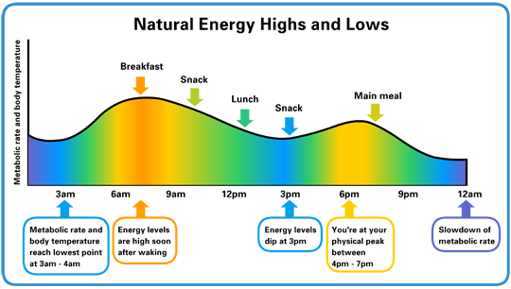
HAVE YOU EVER NOTICED YOUR MOST PRODUCTIVE TIME AT WORKPLACE IN A DAY?

Slide 4

TIME ROBBERS
A "time robber" is something which distracts us from doing important tasks which have more value in projects with limited time.
The "time robbers" cause us to consume large chunks of time in relatively unproductive, low-value activities.

Slide 5
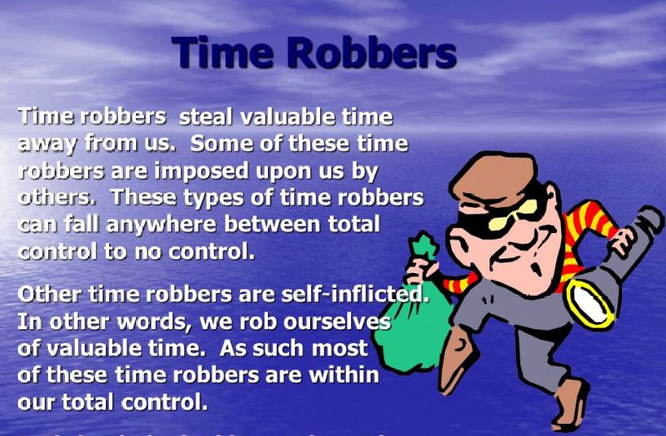

Slide 6
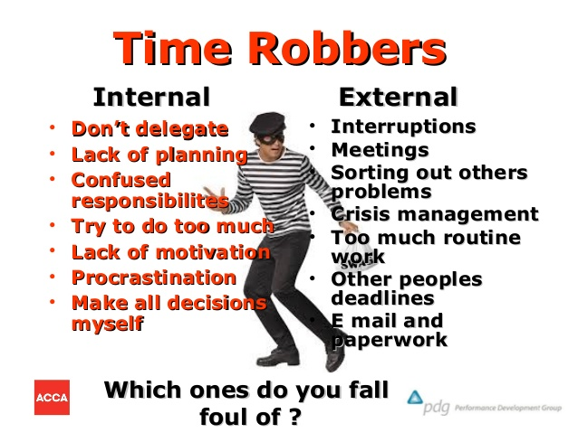

Slide 7
ON TIME PROJECT COMPLETION- A Challenge
Managers often cite delivering projects on time as one of their biggest challenges.
Time has the least amount of flexibility; it passes no matter what happens on a project.
Schedule issues are the main reason for conflicts on projects, especially during the second half of projects.
However if Project Manager keeps his/ her eyes open and be aware of what activities are actually contributing delays in project completion, many of these parasitic losses of time can be managed.

Slide 8

SCHEDULE MANAGEMENT
The role of a project manager is like that of an orchestra's conductor:
to harmoniously bring all the elements of a project together so project completion can be achieved. Time management for a project manager is like the conductor's baton. It's the simple focal point that keeps all other processes moving.

Slide 9
SCHEDULE MANAGEMENT
Project Schedule Management includes the processes required to manage the timely completion of the project.
Project scheduling provides a detailed plan that represents how and when the project will deliver the products, services, and results defined in the project scope and serves as a tool for communication, managing stakeholders’ expectations, and as a basis for performance reporting.

Slide 10
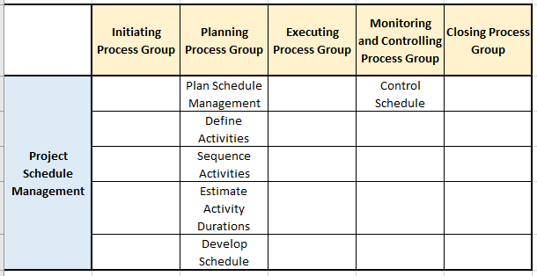

Slide 11
PLAN SCHEDULE MANAGEMENT
Plan Schedule Management is the process of establishing the policies, procedures, and documentation for planning, developing, managing, executing, and controlling the project schedule.
The key benefit of this process is that it provides guidance and direction on how the project schedule will be managed throughout the project

Slide 12
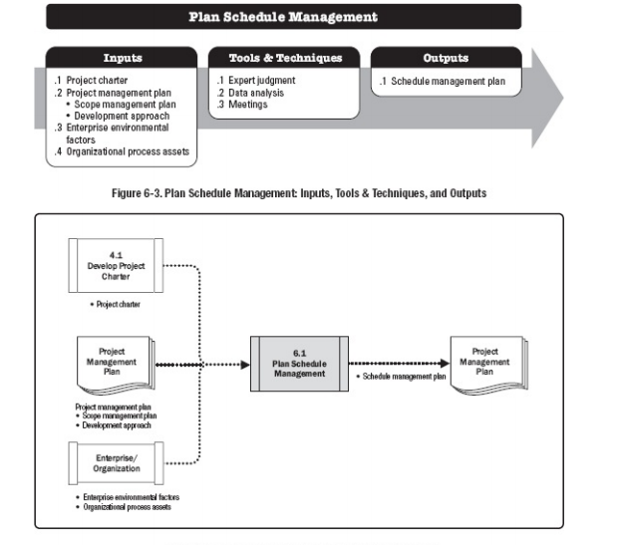

Slide 13
INPUTS
1- PROJECT CHARTER
2-PROJECT MANAGEMENT PLAN
Scope management plan.
Development approach
3- ENTERPRISE ENVIRONMENTALFACTORS :The enterprise environmental factors that can influence the Plan Schedule Management process include but are not limited to: Organizational culture and structure, Team resource availability and skills and physical resource availability, Scheduling software and so on.
4- ORGANIZATIONALPROCESS ASSETS The organizational process assets that can influence the Plan Schedule Management process include but are not limited to: Historical information and lessons learned repositories; Templates and forms and so on.

Slide 14
TOOLS AND TECHNIQUES
1- EXPERT JUDGMENT
Expertise should be considered from individuals or groups with specialized knowledge or training in previous, similar projects
2- DATA ANALYSIS
A data analysis technique that can be used for this process includes but is not limited to alternatives analysis. Alternatives analysis can include determining which schedule methodology to use, or how to combine various methods on the project. It can also include determining how detailed the schedule needs to be, the duration of waves for rolling wave planning, and how often it should be reviewed and updated.
3- MEETINGS Project teams may hold planning meetings to develop the schedule management plan. Participants at these meetings may include the project manager, the project sponsor, selected project team members, selected stakeholders, anyone with responsibility for schedule planning or execution, and others as needed.

Slide 15
OUTPUT
SCHEDULE MANAGEMENT PLAN
Project schedule model development. The scheduling methodology and the scheduling tool to be used in the development of the project schedule model are specified.
Release and iteration length. When using an adaptive life cycle, the time-boxed periods for releases, waves, and iterations are specified.
Level of accuracy. The level of accuracy specifies the acceptable range used in determining realistic activity duration estimates and may include an amount for contingencies.
Units of measure. Each unit of measurement (such as staff hours, staff days, or weeks for time measures, or meters, liters, tons, kilometers, or cubic yards for quantity measures) is defined for each of the resources.
Organizational procedures links. The work breakdown structure (WBS) provides the framework for the schedule management plan, allowing for consistency with the estimates and resulting schedules.
Project schedule model maintenance. The process used to update the status and record progress of the project in the schedule model during the execution of the project is defined.
Control thresholds. Variance thresholds for monitoring schedule performance may be specified to indicate an agreed-upon amount of variation to be allowed before some action needs to be taken.
Rules of performance measurement. Earned value management (EVM) rules or other physical measurement rules of performance measurement are set.
Reporting formats.

Slide 16
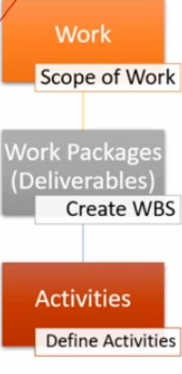
2- DEFINE ACTIVITIES
Define Activities is the process of identifying and documenting the specific actions to be performed to produce the project deliverables.
The key benefit of this process is that it decomposes work packages into schedule activities that provide a basis for estimating, scheduling, executing, monitoring, and controlling the project work

Slide 17
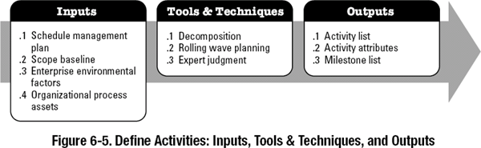

Slide 18
INPUT
1 PROJECT MANAGEMENT PLAN
Schedule management plan.
Scope baseline.
ENTERPRISE ENVIRONMENTALFACTORS
Organizational cultures and structure, Published commercial information from commercial databases and so on.
ORGANIZATIONALPROCESS ASSETS
Lessons learned
Historical information
Standardized processes
Templates and so on

Slide 19
TOOLS & TECHNIQUES
1- EXPERT JUDGMENT
Expertise should be considered from individuals or groups with specialized knowledge of similar past projects and the work being performed.
2- DECOMPOSITION
Decomposition is a technique used for dividing and subdividing the project scope and project deliverables into smaller, more manageable parts.
3- ROLLING WAVE PLANNING
Rolling wave planning is an iterative planning technique in which the work to be accomplished in the near term is planned in detail, while work further in the future is planned at a higher level
4- MEETINGS
Meetings may be face-to-face, virtual, formal, or informal

Slide 20
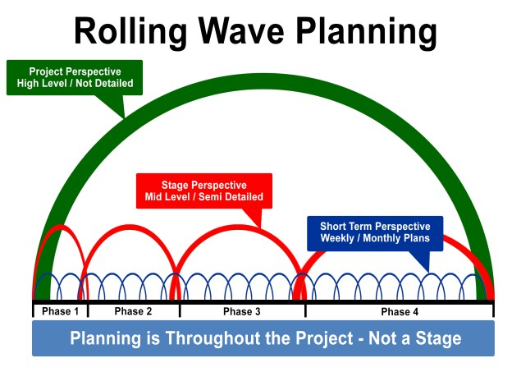

Slide 21
OUTPUT
1 ACTIVITY LIST The activity list includes the schedule activities required on the project.
2- ACTIVITY ATTRIBUTES Activity attributes extend the description of the activity by identifying multiple components associated with each activity. The components for each activity evolve over time. During the initial stages of the project, they include the unique activity identifier (ID), WBS ID, and activity label or name. When completed, they may include activity descriptions, predecessor activities, successor activities, logical relationships, leads and lags, resource requirements, imposed dates, constraints, and assumptions.
3 MILESTONE LIST
4- CHANGE REQUESTS
Once the project has been baseline, the progressive elaboration of deliverables into activities may reveal work that was not initially part of the project baselines. This may result in a change request.
5- PROJECT MANAGEMENT PLAN UPDATES
Schedule baseline
Cost baseline.

Slide 22
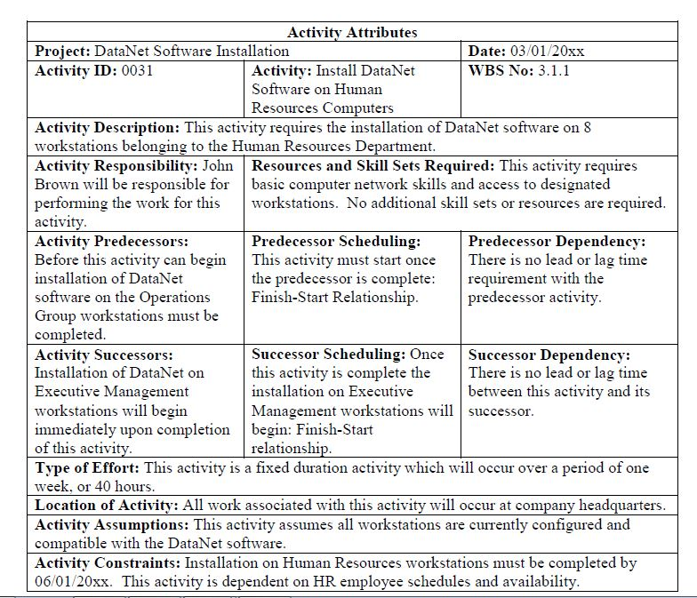

Slide 23
3 DIFFERENT ACTIVITY LISTS FOR ONE WBS
There is always more than one way to do a job. We just see two different ways of doing the same project; three different activity lists.
And you can see that each one would have a different schedule, a different budget and last but not the least a different monitoring mechanism as well.

Slide 24

SEQUENCE ACTIVITIES
Sequence Activities is the process of identifying and documenting relationships among the project activities.
The key benefit of this process is that it defines the logical sequence of work to obtain the greatest efficiency given all project constraints

Slide 25
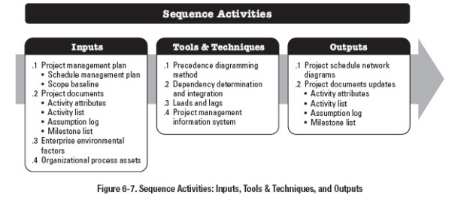

Slide 26
INPUT
PROJECT MANAGEMENT PLAN
Schedule management plan.
Scope baseline
PROJECT DOCUMENTS
Activity attributes.
Activity list.
Assumption log
Milestone list
ENTERPRISE ENVIRONMENTALFACTORS
Government or industry standards,Project management information system (PMIS) and so on.
ORGANIZATIONALPROCESS ASSETS
Templates, Lessons learned repository, historical information and so on.

Slide 27
TOOLS AND TECHNIQUES
PRECEDENCE DIAGRAMMING METHOD
It is a technique used for constructing a schedule model in which activities are represented by nodes and are graphically linked by one or more logical relationships to show the sequence in which the activities are to be performed.

Slide 28
PDM includes four types of dependencies or logical relationships.
Finish-to-start (FS)- (95%). A logical relationship in which a successor activity cannot start until a predecessor activity has finished.
Finish-to-finish (FF). A logical relationship in which a successor activity cannot finish until a predecessor activity has finished
Start-to-start (SS). A logical relationship in which a successor activity cannot start until a predecessor activity has started.
Start-to-finish (SF). A logical relationship in which a successor activity cannot finish until a predecessor activity has started.

Slide 29
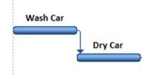
FS Relationship
For example installing the operating system on a PC cannot start until the PC hardware is assembled.
An example of FS relationships is car washing. We wash the car, dry the car

Slide 30
Finish-to-finish (FF)
broadcast of a football match cannot finish until the match is finished.
,writing a document is required to finish before editing the document can finish.

Slide 31
Start-to-start (SS)
For example, level concrete (successor) cannot begin until pour foundation (predecessor) begins.

Slide 32
Start-to-finish (SF).
For example, a new accounts payable system (successor) has to start before the old accounts payable system can be shut down (predecessor).

Slide 33
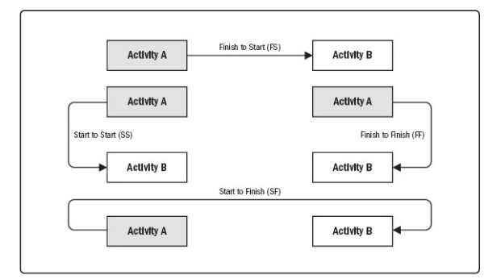

Slide 34
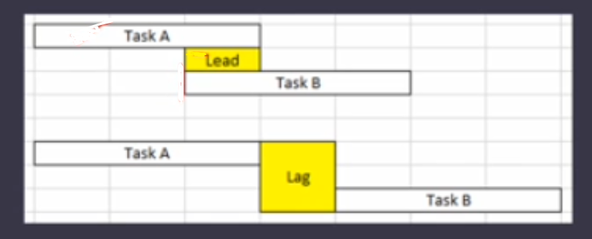
LEADS AND LAGS
A lead is the amount of time a successor activity can be advanced with respect to a predecessor activity. Letting an activity begin and conduct in parallel with the predecessor.
A lag is the amount of time a successor activity will be delayed with respect to a predecessor activity. It is the waiting time between two activities.

Slide 35
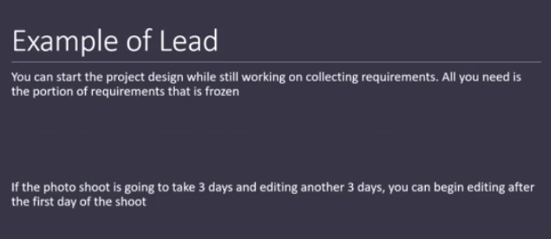

Slide 36
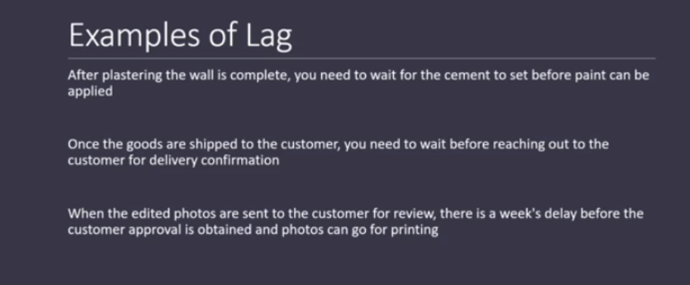

Slide 37
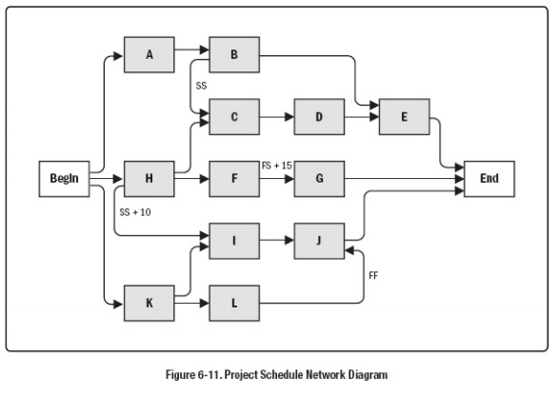

Slide 38
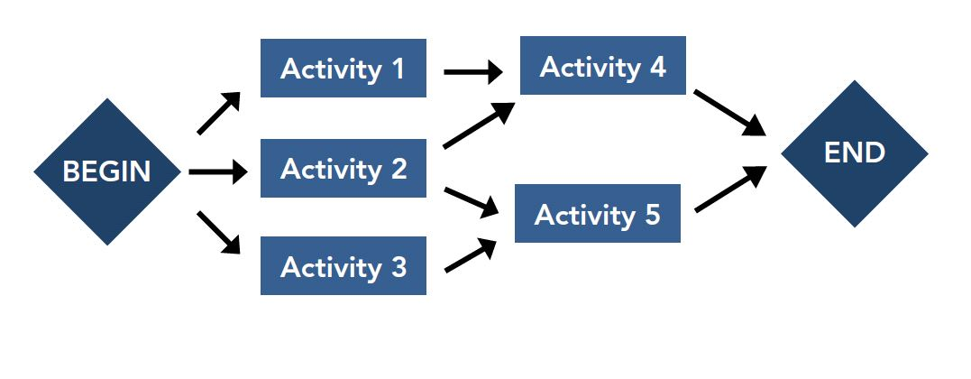
OUTPUT
1- PROJECT SCHEDULE NETWORK DIAGRAMS
A project schedule network diagram is a graphical representation of the logical relationships, also referred to as dependencies, among the project schedule activities. A project schedule network diagram is produced manually or by using project management software.
2- PROJECT DOCUMENTS UPDATES
Activity attributes.
Activity list.
Assumption log.
Assumptions and constraints
Milestone list.

Slide 39
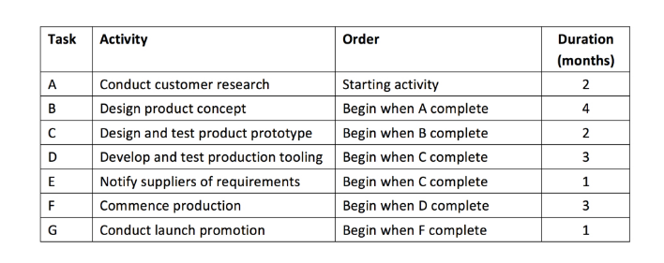
Class Exercise

Slide 41
ESTIMATE ACTIVITY DURATIONS
Estimate Activity Durations is the process of estimating the number of work periods needed to complete individual activities with estimated resources.
The key benefit of this process is that it provides the amount of time each activity will take to complete

Slide 42
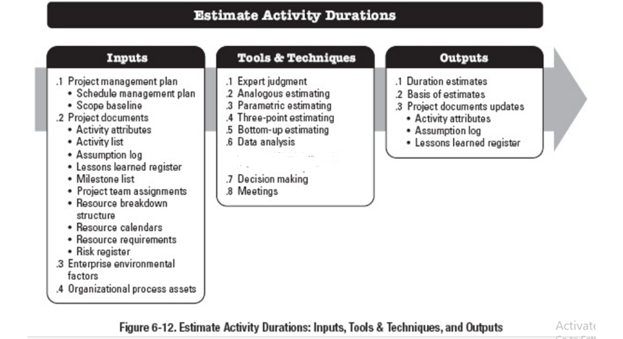

Slide 43
1- PROJECT MANAGEMENT PLAN
The schedule management plan
Scope baseline.
2-PROJECT DOCUMENTS
3-EEF
4-OPAs

Slide 44
TOOLS AND TECHNIQUES
1- EXPERT JUDGMENT
Expertise should be considered from individuals or groups with specialized knowledge or training
2- ANALOGOUS ESTIMATING Analogous estimating is a technique for estimating the duration or cost of an activity or a project using historical data from a similar activity or project.
3-PARAMETRIC ESTIMATING Parametric estimating is an estimating technique in which an algorithm is used to calculate cost or duration based on historical data and project parameters. Parametric estimating uses a statistical relationship between historical data and other variables (e.g., square footage in construction) to calculate an estimate for activity parameters, such as cost, budget, and duration.
4-DATA ANALYSIS
5-DECISION MAKING-Fist of five
6-Meeting

Slide 45
THREE-POINT ESTIMATING The accuracy of single-point duration estimates may be improved by considering estimation uncertainty and risk.
Using three-point estimates helps define an approximate range for an activity's duration:
Most likely (tM) based on reality Optimistic (tO). best-case scenario Pessimistic (tP). worst-case scenario
Depending on the assumed distribution of values within the range of the three estimates, the expected duration, tE, can be calculated. One commonly used formula is triangular distribution: tE = (tO + tM + tP) / 3.

Slide 46
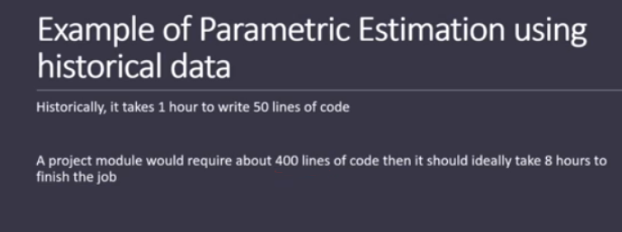

Slide 47
OUTPUTS
1- DURATION ESTIMATES
2-BASIS OF ESTIMATES. Supporting detail for duration estimates may include:
Documentation of the basis of the estimate (i.e., how it was developed)
Documentation of all assumptions made
Documentation of any known constraints
Indication of the range of possible estimates (e.g., ±10%) to indicate that the duration is estimated between a range of values)and so on
3- PROJECT UPDATES

Slide 48
DEVELOP SCHEDULE
Develop Schedule is the process of analyzing activity sequences, durations, resource requirements, and schedule constraints to create a schedule model for project execution and monitoring and controlling
The key benefit of this process is that it generates a schedule model with planned dates for completing project activities

Slide 49
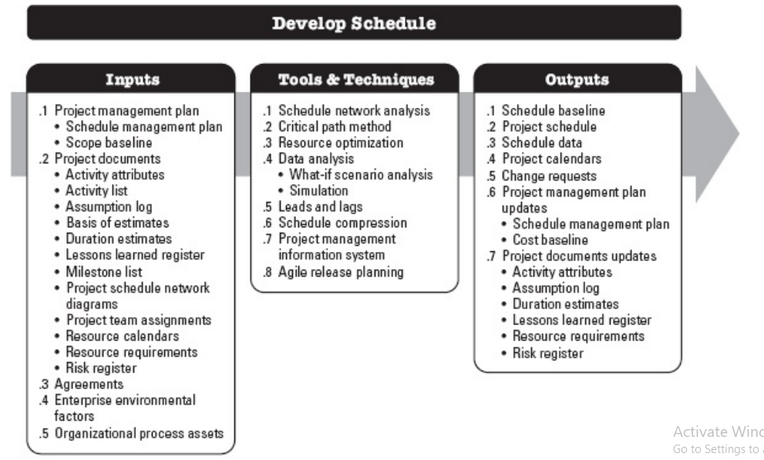

Slide 50
CRITICAL PATH METHOD
The critical path method (CPM) is a step-by-step project management technique for process planning that defines critical and non-critical tasks with the goal of preventing time-frame problems
This schedule network analysis technique calculates the early start, early finish, late start, and late finish dates for all activities without regard for any resource limitations by performing a forward and backward pass analysis through the schedule network

Slide 51
EARLY START
ES
EARLY FINISH
ACTIVITY
EF
FOAT/ SLACK
FOAT/ SLACK
LS
DURATION
LF
LATE FINISH
LATE START
Early Start – The earliest time that an activity can start according to the logical constraints.
Duration – The estimated time to undertake the activity.
Early Finish – The earliest time that an activity can finish according to logical constraints.
Early Start + Duration = Early Finish
Late Start – The latest time that an activity can start according to logical constraints and without affecting the overall project duration.
Late Finish – The latest time that an activity can finish according to logical constraints and without affecting the overall project duration. Late Finish – Duration = Late Start
Float – The time by which an activity may be delayed without affecting the overall project duration. Latest Finish/Start – Earliest Finish/Start = Float

Slide 52
CRITICAL PATH METHOD
ACTIVITY | PREDECESSOR | DURATION
A | - | 3
B | A | 4
C | A | 2
D | B | 5
E | C | 1
F | C | 2
G | D,E | 4
H | F,G | 3

Slide 53
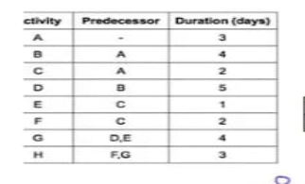
CPM

Slide 54
CRITICAL PATH
The critical path is the longest sequence of activities in a project plan which must be completed on time for the project to complete on due date.

Slide 55
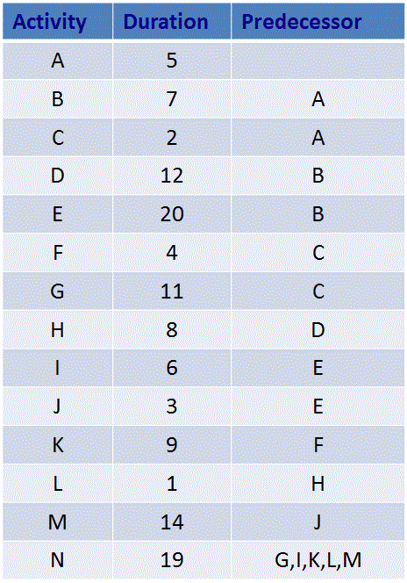
Exercise!

Slide 56
CONTROL SCHEDULE
Control Schedule is the process of monitoring the status of the project to update the project schedule and managing changes to the schedule baseline.
The key benefit of this process is that the schedule baseline is maintained throughout the project.

Slide 57
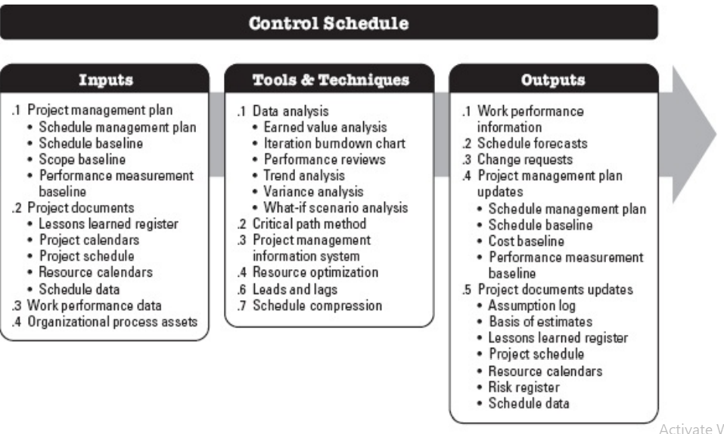

Slide 58
Resource Leveling and Crashing
Fast Tracking:
  a method of accelerating a project to deliver the end product sooner. Fast-tracking in project management is a schedule compression technique often used alongside the crashing technique.
Crashing:
  Crashing is a technique of reducing the project's duration by adding more resources or increasing their productivity to the critical path tasks. Crashing aims to shorten the critical path by decreasing the time required to complete the tasks. However, crashing usually involves additional costs, such as paying for overtime, hiring, or outsourcing. Therefore, crashing should be used only when the benefits of finishing the project earlier outweigh the costs of adding more resources.

